Slide 1


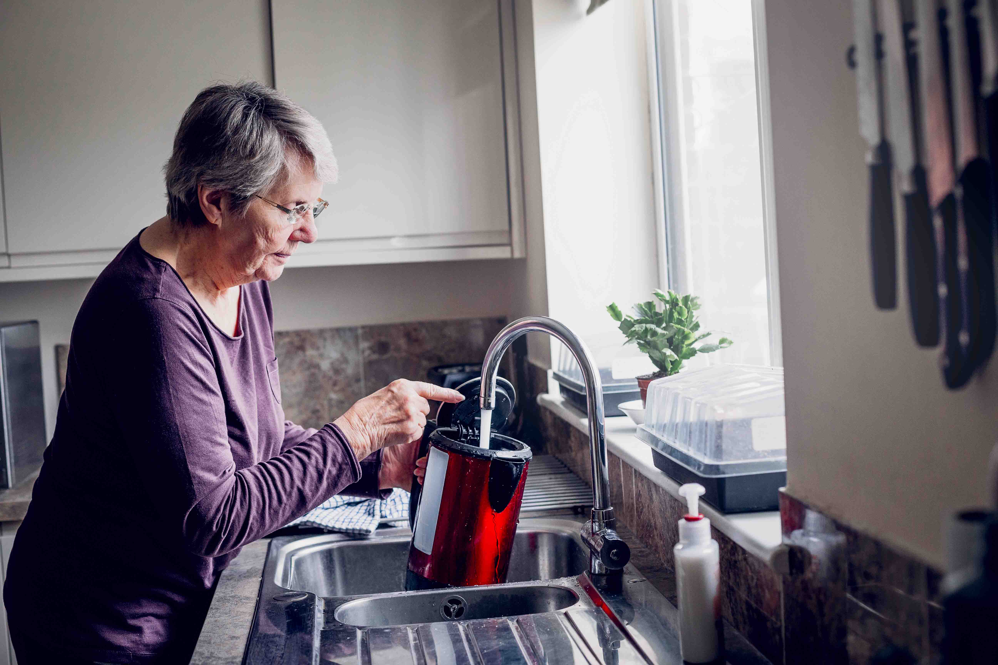

Nursing Home Support Scheme
Fair Deal
Brought to you by
Cornmarket’s Tax Return Service
Cornmarket Group Financial Services Ltd. is a member of the Irish Life Group Limited which is part of the Great-West Lifeco Group of companies. Cornmarket’s Tax Return Service is not a regulated financial product.

Slide 2

Todays agenda
1
What is Fair Deal?
2
What does it cover?
3
How does it work?
4
What is Ancillary Support?

Slide 3



What is the Fair Deal Scheme?
Cost of a Nursing Home place is managed by HSE
Allows either the full or a portion of cost to be covered by the State
Gives an option to defer the residents portion of cost

Slide 4

Fair Deal - What it Covers
It covers the level of care appropriate
to the individual.
It covers bed, board & laundry for the resident.
It covers certain therapeutic activities & aids / appliances needed for daily living.
If resident qualifies for a medical card,
this covers the cost of aids / appliances
& medical aid (GP charges, medication)
If there is no medical card, the individual
or family must cover the above costs.

Slide 5

Application Process
Let us do the work for you
1
An application can take from 4-6 weeks
2
Complete Care Needs Assessment
3
Complete Financial Assessment
Important to remember if an individual is admitted directly from a hospital before approval of Fair deal, the HSE will not cover cost.
4
Ancillary State Support
5
Research Nursing Homes

Slide 6

Care Assessment
Carried out by a healthcare professional appointed by HSE
Assess the ability to carry out daily activities of applicant
The medical and health needs of applicant.
The family & community supports available.
The applicants own wishes.

Slide 7

Financial Assessment
The financial assessment will determine what portion of the cost an individual pays. The financial assessment will look at the entire income of the individual or, if the individual is part of a couple, half of their combined income.
The individual is asked to list their assets, providing a valuation of each including:
Property (home, property leased out, business premises, farm land etc.)
Cash (pensions, interest on bonds savings earned income).
An individual is allowed €36,000 and a couple are allowed €72,000 in savings, which is not assessed.

Slide 8



Example 1
Married couple - One needs long-term care
Nursing Home Cost
€52K per year
  State Contribution is €20,555
  Family cost is
  €31,445 (€2,620 pm)
  Reducing to
  €18,320 after 3yrs
Contributory Pension | €12,900
Contributory Pension-Spouse | €12,900
Private Pension Income | €20,000
Savings | €50,000
Investments | €20,000
Family Home | €350,000
Ancillary State
Support Option
  First 3 years of family contribution is offset against future sale of property
  €31,445 x 3 years = €94,355
40% of Income
€ 18,320
3.75% of Cash Assets (less €72K)
0
3.75% of Principal Residence *
€13,125
Total Family Yearly Contribution Year 1 / 2 / 3
€31,445
Total Family Yearly Contribution Year 4 and onwards
€18,320

Slide 9
Example 2
Married couple - One needs long-term care
Contributory Pension | €12,900
Contributory Pension-Spouse | €12,900
Private Pension Income | €65,000
Savings | €60,000
Investments | €300,000
Family Home | €1,000,000
  Applicants income exceeds cost of nursing home(€52k)
  Too late to gift as HSE “look back” 5 years
  If Assets/Cash rich then Fair Deal is punitive and unlikely to be used
40% of Income
€36,320
3.75% of Cash Assets (less €72K)
€10,800
3.75% of Principal Residence *
€37,500
Total Family Yearly Contribution
€84,620
*Primary residence only, does not include investment properties or holiday homes.

Slide 10
Research Nursing Homes
The application process provides option to “choose” three different Nursing Home’s for consideration.
These are up to the applicant or family to research and enter in application.
The applicant must take the first available place in one of the three options.
No transfer or second pick is allowed under this process.

Slide 11




Thank You
If you need any help with your tax affairs we are available on:
(01) 408 4106
tax@cornmarket.ie
For more information:
Cornmarket.ie/tax-return-service/
The information has been sourced by Cornmarket and all figures are correct as of 01/12/2020.
Cornmarket Group Financial Services Ltd. is a member of the Irish Life Group Limited which is part of the Great-West Lifeco Group of companies. Cornmarket’s Tax Return Service is not a regulated financial product.

